Slide 1

Fraud Data Analytics
Rohit Metri

Slide 2
Fraud and money laundering are significant risks for financial institutions, and data analytics plays a crucial role in detecting and preventing these crimes. By using tools like SQL and data analysis techniques, financial institutions can improve their ability to detect and prevent fraud and money laundering
"The most important thing in finance is to have the right information, and to be able to analyze it correctly, but also to be aware of the risks of financial fraud."
- Warren Buffett

Slide 3
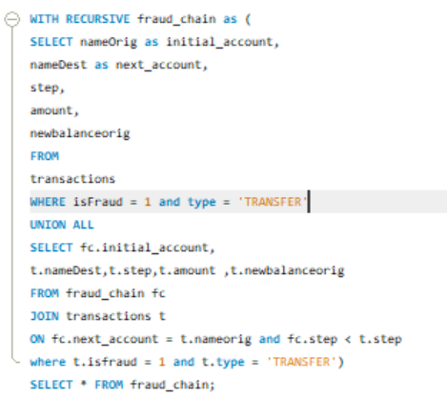
1. Detecting Recursive Fraudulent Transactions
Using a recursive CTE to identify potential money laundering chains where money is transferred from one account to another across multiple steps, with all transactions flagged as fraudulent.
This query uses a recursive CTE to track the flow of money through multiple accounts over successive steps. The recursive part of the CTE allows us to follow the chain of transactions and identify patterns that could indicate money laundering activities. It filters out chains where all transactions are marked as fraudulent.

Slide 4
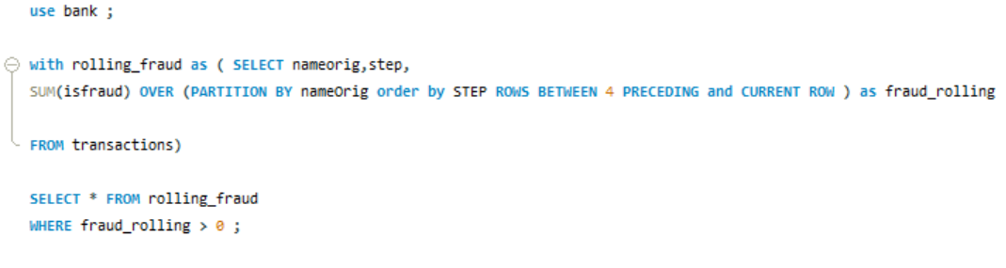
2. Analyzing Fraudulent Activity over Time
Using a CTE to calculate the rolling sum of fraudulent transactions for each account over the last 5 steps. This query uses a CTE to calculate the cumulative sum of fraudulent transactions for each account over the last five steps. It helps in understanding the temporal distribution of fraudulent activities, which is crucial for identifying patterns over time.

Slide 5
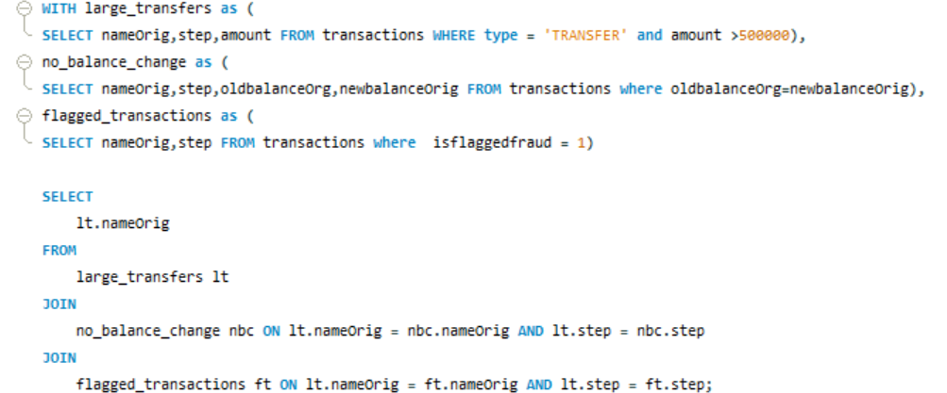
3. Complex Fraud Detection Using Multiple CTES
Using multiple CTEs to identify accounts with suspicious activity, including large transfers, consecutive transactions without balance change, and flagged transactions.

Slide 6
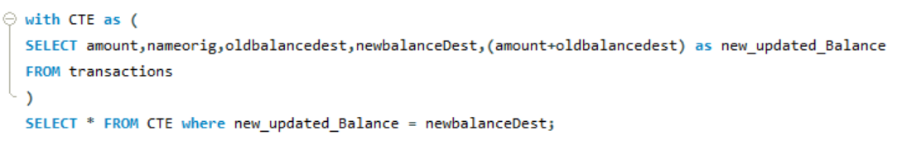
4. A query that checks if the computed new balance is the same as the actual new balanceDest in the table. If they are equal, it returns those rows.

